Slide 1

Analysis of Efficiency of Fama French Three Factor Model on Pakistani Stock Market

Slide 2
Research Objectives
Is there any Market Risk Premium in Pakistan stock market?
Is there any size premium in Pakistan stock market?
Is there any value premium in Pakistan stock market?
Is Fama French 3 factor model suitable for Pakistan’s stock market?

Slide 3
Research Methodologies
Data Collection.
-) PSX All financial information. -) Khi-Stocks used for share prices.
Method of Analysis.
-) Linear Regression Model -) Mean
-) Mean -) Standard Deviation
-) T-Test
Portfolio Creation.
-) Book equity / Market Cap and Market Cap / Total Assets
-) Below 50th Percentile is Small and above 50th Percentile is Big.
-) Below 30th Percentile is Low and above 70th Percentile is High.

Slide 4
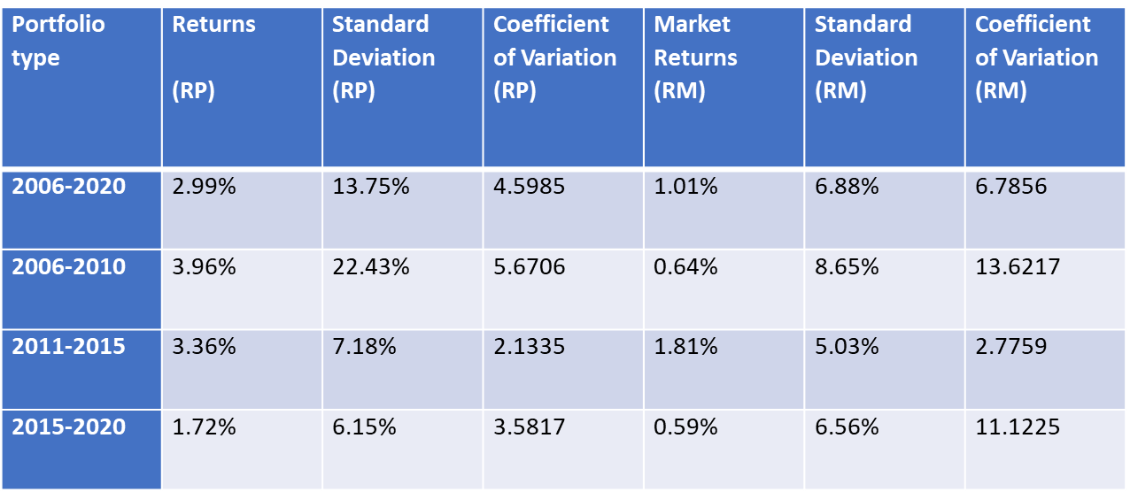
Results

Slide 5
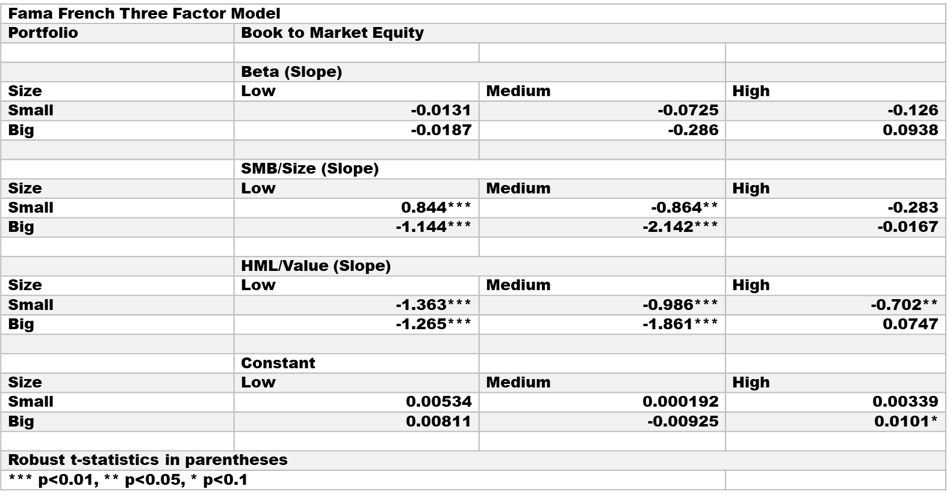
Results

Slide 6
Recommendation:
In my opinion we can make it a better model by taking different parameters for portfolios.
There are other factors as well which can create an impact on excess returns. We can extend our research to fama French five factor model.
There are other model as well to find the out excess returns therefore we can do a comparative study with other model as well.

Slide 7
Thank You

